Slide 1



Unsupervised ML
Flight price Dataset

Slide 2

Overview
In this version of report, I used the unsupervised ML algorithms like Kmeans, DB scan and Hierarchal mean clustering, later on I used Isolation forest, LOF and Dbscan for the local and global outliers detection

Slide 3
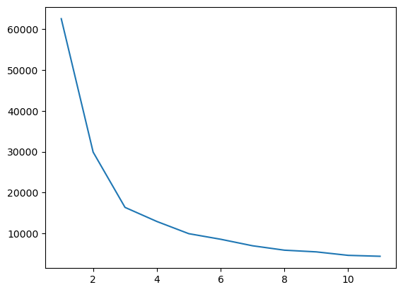
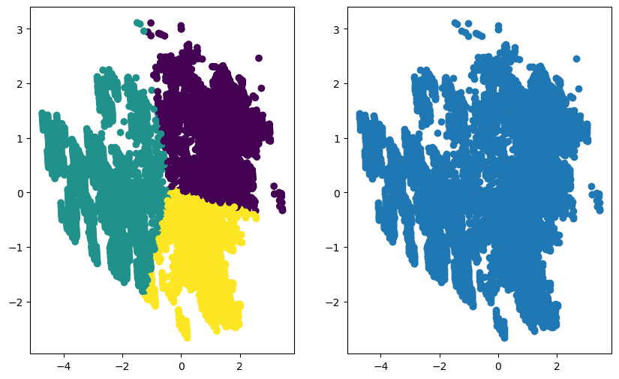
Kmeans Clustering
WCSS score then K=3
silhouette_score : 0.5034780782274063

Slide 4
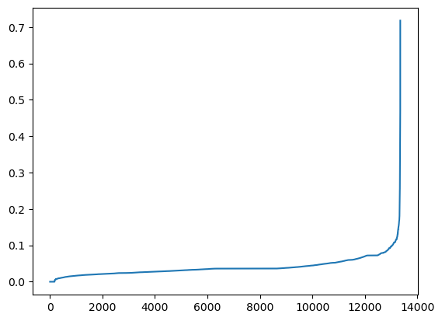
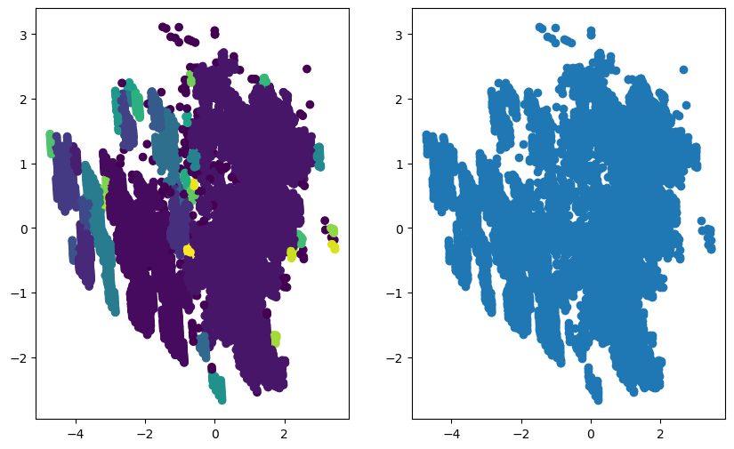
DB scan clustering
eps = 0.095, based on graph
silhouette_score : -0.3345198845303157

Slide 5
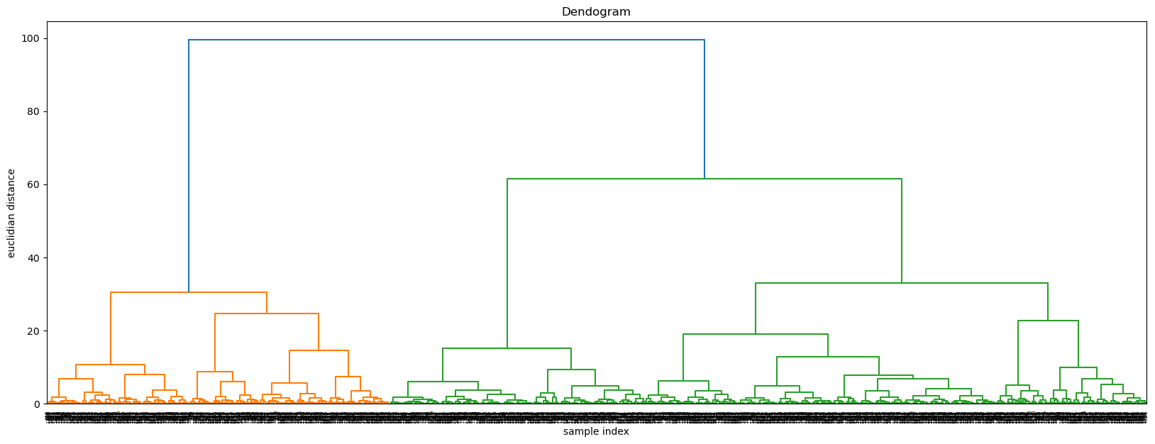
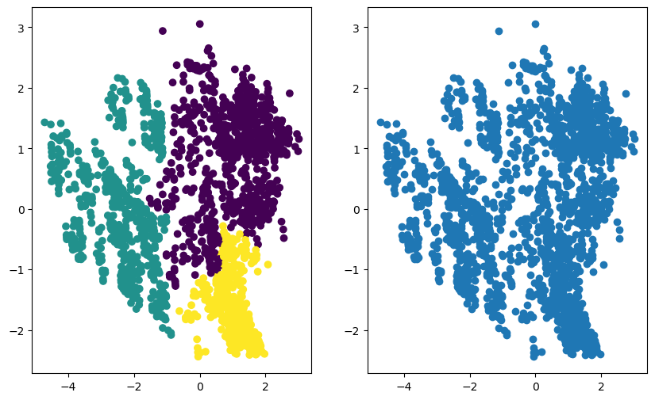
HM clustering
Dendogram then n = 3
silhouette_score : 0.4703484162622101

Slide 6
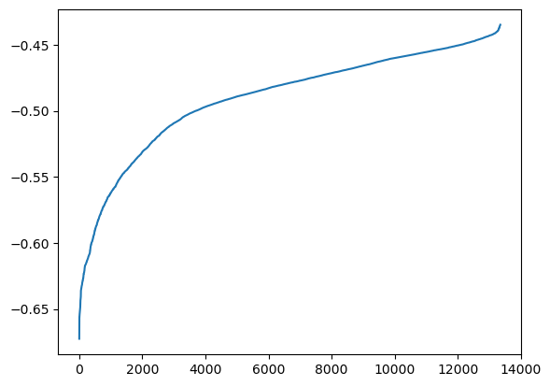
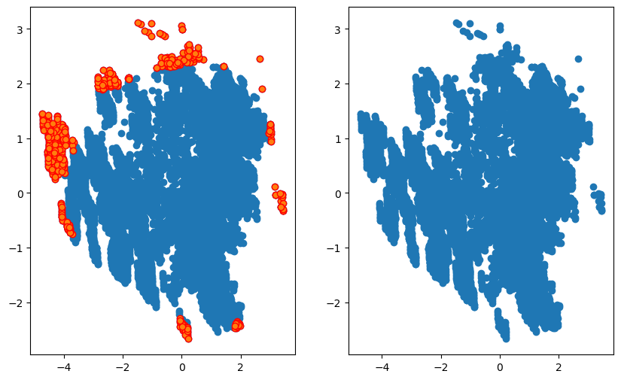
Isolation Forest : Global Outliers
In Isolation forest, I first made the graph shown below using the contamination as auto, then based on this graph later I came up with contamination = 0.04 and then made the outliers.
Graph : outliers(global)

Slide 7
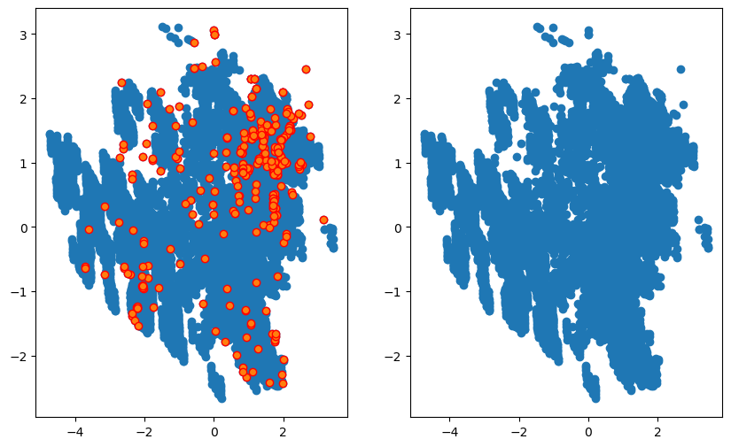
LOF : Local Outliers
For local outliers, I used LOF from sklearn.neighbors libaray, I set the value of n_neighbors = 5, algorithm = ‘auto’

Slide 8
Thanks for watching, ☺

